Slide 1


Graph Embeddings
MACC Conference
November 5th, 2020
Dan McCreary
Distinguished Engineer
Advanced Technology Collaborative
Notes:
Hi – my name is Dan McCreary. I am a Distinguished Engineer working in the Advanced Technology Collaborative. I am leading the graph technologies initiative within the Optum Advanced Technology Collaborative. Our goal is to build a collaborative community the use graph technology to lower the cost of healthcare and give Optum a competitive advantage in the marketplace.

Slide 2
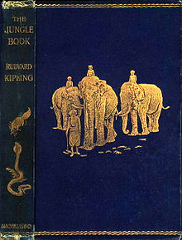

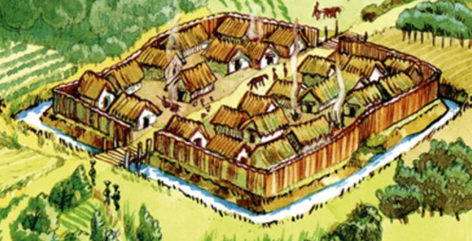
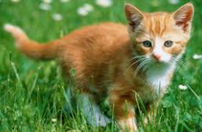

Storytelling – The Setting
Walled Village
Mowgli’s Kitten
Mowgli
The Jungle Book
by Rudyard Kipling
Path Near Village

Slide 3

While Walking Down the Path…
Mowgli sees a …
…which is very similar to Mowgli’s Kitten
Mowgli
decides to..
Run back to the village for safety
fear
Think Parallel Processing
danger
safety
Proceed down the path
An example of a real-time existential threat assessment.

Slide 4
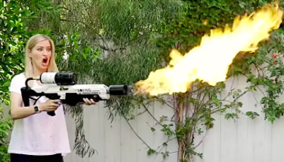

Acme E-Commerce Inc.
A shopper is looking for a
baby shower gift
Your product recommendation engines suggests this lovely flame thrower!
Real-time similarity is an existential threat for companies that are not recommending the right products!

Slide 5
Agenda
What are graph embeddings?
What do we mean by real-time?
What is Serial vs. Parallel computation?
What do we mean by “similar”?
How do we use embeddings in applications?
How do we create and maintain embeddings?
Why are graph embeddings universal?
How can systems integrate them?
Notes:
This is a high-level agenda of what we want to cover in this session. We are going to start out with some external forces in the database market happening outside of Optum. We will focus on how companies in the Bay Area, like Google, Facebook and LinkedIn have created a competitive advantage using graph technology. We will then explain what a graph databases is and how it is different than a traditional relational database. Next we will discuss graph use cases in healthcare and some of the standards and vendors in the marketplace today. We will then wrap up with some issues around training and resource for you to learn more about graph technologies.

Slide 6
What is a Graph Embedding?
Embedding
Customer Data
Or Any Subgraph
A data structure used to create fast similarity calculations
Usually stored as a fixed-length vector of scalers
Optimized for fast parallel comparison

Slide 7
Product Recommendation
Customer Data
Customer Embedding
Product
Taxonomy
Demographics
Products
Region
C1
C2
C3
C4
Product Categories
Prior Purchases
Web Logs
P1
P2
P3
P4
P5
P6
P7
P8
Products
Searches
Returns
Complaints
Product Embedding
Given a context, what similar customers buy what similar products?

Slide 8
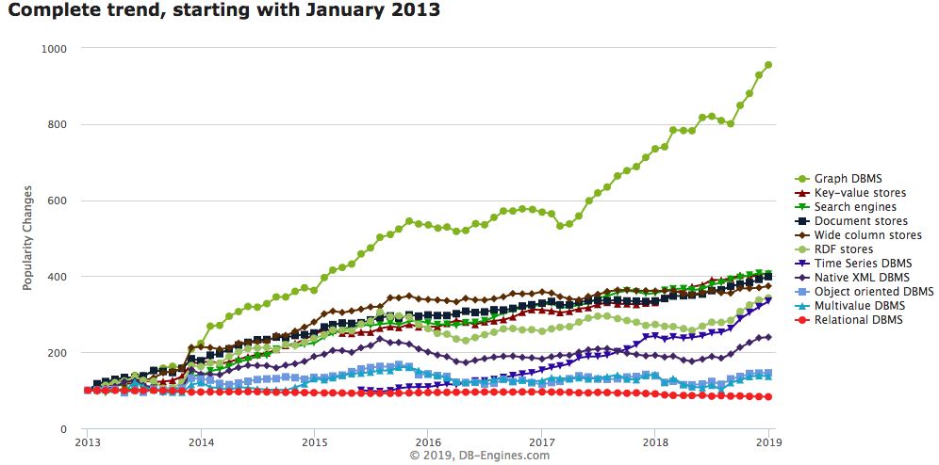
Graph Databases are HOT!
Graph Databases
https://db-engines.com/en/ranking_categories
Notes:
This chart shows the relative change in popularity of graph databases compared to other technologies according to DB Engines. DB Engines has web crawlers that regularly harvest an classify data related to databases. You can see that Graph Database popularity is the fasting growing database technology. This trend started in 2013 and it is continuing strong in 2018. Note that is is not absolute popularity. This is the change is popularity. Popularity also does not imply suitability. However, with these disclaimers aside you can clearly see a sustainable trend. Let’s see what other evidence we have about the rise of graph technologies.

Slide 9
Relational vs. Graph
Relational (row store)
Graph
ID
NAME
DATE
AMOUNT
Atomic unit of storage is a row of a table and data is appended to a table one row at a time
All columns within a table must have the same structure and no variations within a table are allowed
Table structures are fixed after design – all rows have the same structure
Relationship traversal is done via JOINs at runtime using log(N) search’s calculated at query time
Difficult to distribute over a cluster of 100+ nodes
Atomic unit of storage are nodes and edges
Each node and edge may have independent properties that are determined at run time (schema agnostic)
Joins between nodes and edges are computed at load time and are stored as memory pointers
Relationships traversal is done using pointer hopping – each core can evaluate 2M hops per second
Distributed graph products are new
Notes:
Now lets do a side-by-side comparison of both the traditional Relational row-store and compare some key facts. With a row store, the atomic unit of work is adding a single row at a time to a table. The key is that all the datatypes in each column must be the same. If there are dates in the third column and decimals in the fourth column all your data must conform to this standard. The table column structures and datatypes are fixed when you design your database. Once you have a million rows loaded into each table and 10,000 reports created it becomes challenging to modify the database.
Relational database also use the SQL language and they use join operations to dynamically calculate relationships each time the query is run. These calculations are based on binary search algorithms that run in log(N) time where N is the number of rows in each table. As the table grows the searches sale as the log of the number of rows.
Graph databases on the other hand allow you to add any number of nodes and and relationships into your graph database. Each node and relationship has it own properties but there are usually few overarching rules about what datatypes these structures can contain. Graph databases also used fixed memory pointers to store relationships between each node. As a result the queries over relationships are fast and there is no slow-down as the number of verticies gets bigger.

Slide 10
Low Complexity Penalty
Relational
Performance
Penalty
Graph
Relationship
Complexity
Complex systems are easy to model with graph databases
The world is complex
Highly normalize models are a precise representations of the world
We still need to compare things, even if they are complex and have many relationships

Slide 11
Comparing Two Colors
Features
Gold = rgb(255, 215, 0)
Orange = rgb(255,165, 0)
Label | Red | Green | Blue
Gold | 255 | 215 | 0
Red | 255 | 165 | 0
Differences | 0 | 60 | 0
Differences => 0 + 60 + 0 = 60
Sum
Non-normalized Explainable Objective Measure of Similarity

Slide 12
Word Embeddings
Four Words: king, queen, man, woman
Royalty Scale
High Royalty
Association
king
queen
man
woman
Low Royalty
Association
Gender Scale
Male
Female
For any word or phrase, Transformer deep learning NLP models can create word embeddings to find word similarity.
Notes:
https://en.wikipedia.org/wiki/Word_embedding
See also: Thought vectors by Geoffrey Hinton
https://gabgoh.github.io/ThoughtVectors/

Slide 13
Property-based Similarity Example
Target
Population
Used to find the most similar items in a graph by comparing properties and structure
Ideal when you a can compare individual features of an item numerically
Algorithms return a ranking of similarity between a target and a population based on the counts and weights of properties that are similar

Slide 14
Vector Similarity
last
y
Target
1st
Population
x
Vectors are similar in two-dimensional space if they have the same length and direction
Compare all the “x” lengths and the “y” lengths and rank by the sum of the totals of the difference

Slide 15
Vector Representation
x=8
y=10
16
16
8
6
4
3
7
9
-4
6
-4
6
-12
-8
Target Vector
Population Vectors
Each item can be represented by a series of “feature” vectors
The numbers are scalers

Slide 16
Graph to Vector
Target Customer Graph
Key Features
Vector Representation
Gender_Code
Age
Rural_Urban_Score
LTR_Score
Lifetime_Value
CohortCode1
CohortCode2
ProductGroup1
ProductGroup2
ProductGroup3
…200…features
1
47
4
8
9
2
8
18
13
67
…200…integers
Purchases
Extract
Convert
NPS
Demographics
Recommendations
Features should represent both the properties and structure of your customer’s graph

Slide 17
Example: Customer Similarity
Target Customer Vector
Sample Population Vectors
0
43
2
137
1
8
18
13
67
…
…
…
1
45
4
8
9
3
8
15
13
45
…
…
…
1
22
4
3
9
2
8
18
12
32
…
…
…
0
47
4
8
9
2
8
18
13
67
…
…
…
Cosine similarity
Similarity Score:
.80
.85
.92
Graph Similarity algorithms allows graph databases to quickly compare current items with many other items
For any given customer, we can use a fast, in-memory similarity algorithm to compare the key features of any patients to a larger population
Cohort codes can be pre-calculated to quickly narrow the sample population to a smaller group
This calculation is considered a “embarrassingly parallel” query and could be accelerated by adding more nodes to a cluster
Specialized graph hardware such as GPUs and FPGAs can dramatically accelerate these calculations

Slide 18
The Curse of Dimensionality
…various phenomena that arise when analyzing and organizing data in high-dimensional spaces (often with hundreds or thousands of dimensions) that do not occur in low-dimensional settings such as the three-dimensional physical space of everyday experience.
https://en.wikipedia.org/wiki/Curse_of_dimensionality
https://en.wikipedia.org/wiki/Dimensionality_reduction

Slide 19
Serial vs. Parallel Graph Algorithms
Serial Graph Algorithms
Parallel Graph Algorithms
Task
Start
Task
Task
Task
End
Start
Task
End
Task
One task cannot begin before the prior task is complete
Task order is important
Serial Algorithms cannot easily be optimized on FPGAs
Many tasks can be done independently
Task order in not relevent
Tasks can usually be done faster on FPGAs

Slide 20
Does the Human Brain do Serial or Parallel Computation?
The following slide photos of two people
One is a famous actor
The other is a synthetically generated image of a person (generated by a GAN)
Shout out “Left” or “Right” as soon as you can tell which is the famous actor

Slide 21

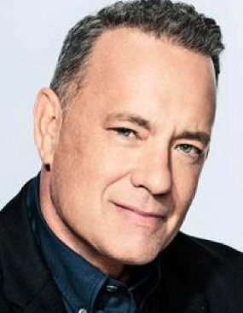

Slide 22
What just happened
The visual cortex received the images as electrical signals from your eyes
Your brain identified key features of each face from the images - in parallel
Your brain sent these features as electrical signals to your memories of people’s faces
Your brain compared these features to every memory you have of a person’s face – in parallel
Your brain sent their recognition scores to a control center of your brain
Your brain’s speech center vocalized the word “right” – in series
Answer: The human brain, comprised of around 84B neurons, does both parallel and series calculations
Two Key Questions:
How does the brain know to pay attention to specific features of a face?
What portions of real-time recommendation systems can be done cost effectively in parallel at low cost?

Slide 23


The Neighboring Village Problem
My Village
Sees a new person on the path
Mowgli
Other Village
Is this person from my village or a nearby village?
How similar is this face to someone I know in my village?
Is this person a threat?

Slide 24
The Product Recommendation Challenge
A customer comes to your web site
You have information on their prior purchases, and they view new products
How quickly can you generate a real-time recommendation based on 10 products and 1 million product reviews?
How much detail can you consider and return the best match in 100 milliseconds?
How quickly can we compare a given customer and their purchases to 1 million other customers and their purchases?
What comparison tasks can be done in parallel?

Slide 25
Don’t Delay a Calculation Over 200 milliseconds (2/10th of a second)
47 percent of visitors expect a website to load in less than 2 seconds
40 percent of visitors will leave the website if the loading process takes more than 3 seconds.
According to Kissmetrics http://www.nngroup.com/articles/how-long-do-users-stay-on-web-pages/
Notes:
http://www.nngroup.com/articles/how-long-do-users-stay-on-web-pages/

Slide 26
The Rise of Automatic Graph Feature Engineering
Recent years have seen a surge in approaches that automatically learn to encode graph structure into low-dimensional embeddings.
The central problem in machine learning on graphs is finding a way to incorporate information about the structure of the graph into the machine learning model.
From Representation Learning on Graphs: Methods and Applications by Hamilton et. El.

Slide 27
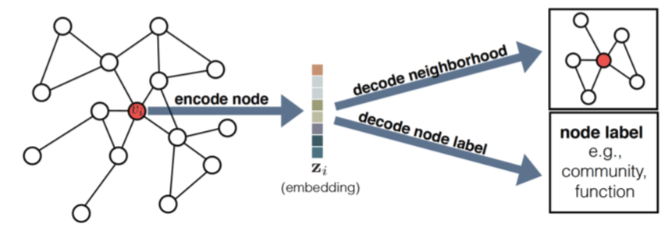
Example of Graph Embedding – Encode and Decode
From Representation Learning on Graphs: Methods and Applications by Hamilton et. El.

Slide 28
Why Are Similarity Calculations Critical?
Similarity is at the foundation of recommendation engines
Recommendation engines power sites like:
Google – recommend a document
NetFlix™ – recommend a movie
Amazon - recommend a product
Pintrest™ – recommend an interest
Healthcare – recommend a care path
Recommendations must take into account many factors including recent searches
To be useful in interactive web sites we set a goal of response times of under 200 milliseconds
Next Best Action
Recommendation
Similarity

Slide 29
Real-Time Patient Similarity
Sample Patient Populations (10s of millions)
Which ones are the most similar to this patient?
New Patient
Arrives in ER
Given a new patient that arrives a clinical setting, how can we quickly find the most similar patients?
Assumption: we have 10M clinical records of our population of 235 million members
Can we find the 100 most similar patients in under 200 milliseconds?

Slide 30
Similarity Score – A scaled measure of “alikeness” for a context
.43
.92
.1
A single scaled dimension of comparison for a given setting or context
Comparing a patient to itself would have a similarity score of 1.0
Patients that have few common characteristics would have a score of 0.1

Slide 31
Graph Representation of Patients – Includes Structure
Sample Patient Population (10M)
Target Patient
Notes:
Finally, lets mention the role of intelligent agents to this process. Agents will be able to access all of these graphs to perform specific tasks for our community of users. Agents will be able to quickly generate specific graph queries that gather just the information they need to perform a task.

Slide 32
Graph Representation of Patients – Includes Structure
Sample Patient Population (10M)
Target Patient
Similarity score = .5
Similarity score = .9
Similarity score = .8
How can I quickly compare these graphs and find the most similar patients?
Notes:
Finally, lets mention the role of intelligent agents to this process. Agents will be able to access all of these graphs to perform specific tasks for our community of users. Agents will be able to quickly generate specific graph queries that gather just the information they need to perform a task.

Slide 33

Xilinx FPGA Implementation
The more items to compare, the longer it takes to fine the top 100 most similar items
FPGA = Field Programable Gate Array
30B transistors that can be rewired in 2 seconds using “C” langauge
Ideal for parallel computation
Benchmarked FPGA implementation of cosine similarity
Open-source versions coming soon
Kumar Deepak
Distinguished Engineer
Xilinx
Note: AMD (90B) recently announced it will acquire Xilinx (30B)

Slide 34
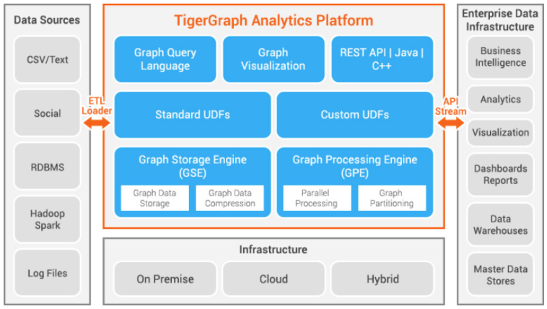
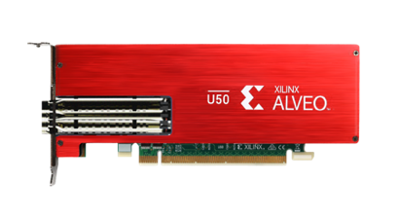
Integration with TigerGraph
<TG Install Dir>/dev/gdk/gsql/src/QueryUdf/ExprFunctions.hpp:
inline string udf_open_alveo(int mode) { … }
inline bool udf_close_alveo(int mode) { … }
inline bool udf_write_device(int mode) { … }
inline ListAccum<testResults> udf_cosinesim_ss_alveo(ListAccum<int64_t>& patient_vector, uint64_t topK) { … }
libxilinxsimilarity.so (code to manage client requests)
Xilinx Runtime (PCIE driver and card management)
similarity.gsql:
open_alveo() { …; udf_open_alveo(1); …}
load_alveo() {…; udf_write_device(1); …}
close_alveo() { …; udf_close_alveo(1); …}
cosinesim_ss_alveo(newPatient, topK) { …; udf_cosinesim_ss_alveo(newPatient, topK); …}
similarity.xclbin

Slide 35
Time (milli-seconds) to get top 100 similar patients
40x faster than CPU
400x faster than CPU
Using one Alveo U50
Using 5 Alveo U50’s
Notes:
In summary, Alveo U50 could meet the challenge

Slide 36
Scaling with number of patients

Slide 37
Three General REST Services to Support Similarity
Similarity Server
Results (csv, JSON)
REST GET
Bulk Upload Data: input - millions of vectors; output – success/failure code
Update Vector: input - vertex ID, 198 integers; output – success/failure code
Find Similar: input - vertex ID, 198 integers; output – 100 vertex IDs (64 bits)

Slide 38
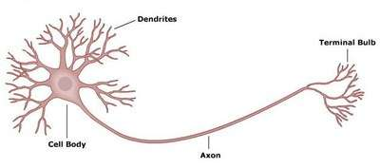
Brain Metaphors and Analogies
Use cautiously
The brain has 82B neurons
Each neuron has 10,000 connections (axons)
Most axons are on “standby” for future learning
Enterprise graphs have billions of vertices but typically have a degree of 5-6
Analogies
A plane is like a bird
A submarine is like a fish
A graph is like a brain

Slide 39

The Deep Learning Bartender
Can I Recommended a Drink?

Slide 40

Explainable AI Models Leverage Graphs
Today
Task
Why did you do that?
Why not something else?
When do you succeed?
When do you fail?
When can I trust you?
How to I correct an error?
Training
Data
Machine
Learning
Process
Learned
Function
Decision or Recommendation
Explainable AI
Task
I understand why
I understand why not
I know when you succeed
I know when you fail
I know when to trust you
I know why you erred
Training
Data
New
Machine
Learning
Process
Explanation
Interface
Explainable Model
https://www.darpa.mil/program/explainable-artificial-intelligence
Notes:
Explainable AI is a key
https://www.darpa.mil/program/explainable-artificial-intelligence

Slide 41

Three Eras of Computing
1) Procedural Era
Data
Programs
Answers
Procedural Code (Rules)
Explanations (Why)
2) Machine Learning Era
Data
Machine
Learning
Rules (10M weights)
Answers
3) Graph Era
Data
Knowledge
Answers
Machine
Learning
Explanations (Why)

Slide 42
Onward to the Hardware Graph!
Algorithmic
Richness
Enterprise
Knowledge
Graph
Hardware
Graph
Single Node
Graph
Data Hub
Data Lake
Scale out

Slide 43
Related Use Cases
Recommendation Engines for Ecommerce and Healthcare
For any person calling in for a recommended provider or senior living facility, can we find similar recommendations in the past?
Document Search
Show similar documents to a search result using document embeddings
Incident Reporting
When trouble ticket is reported, what are the most similar problems and what were their solutions?
Errors in Log Files
When there are are error messages in log files, how can we find similar errors and their solutions?
Learning Content
Can we recommend learning content for employees that have similar goals?
Schema Mapping
Automate the process of creating data transformation maps for new data to existing schemas

Slide 44



Dan.McCreary@optum.com
http://www.linkedin.com/in/danmccreary
http://dmccreary.medium.com
@dmccreary

